Slide 1
Hw for wk 4
To be done in lab, require access

Slide 2
Generate queries on a stressor of interest to you
Study how it is solved with three different solutions
Emo
Int
beh

Slide 3
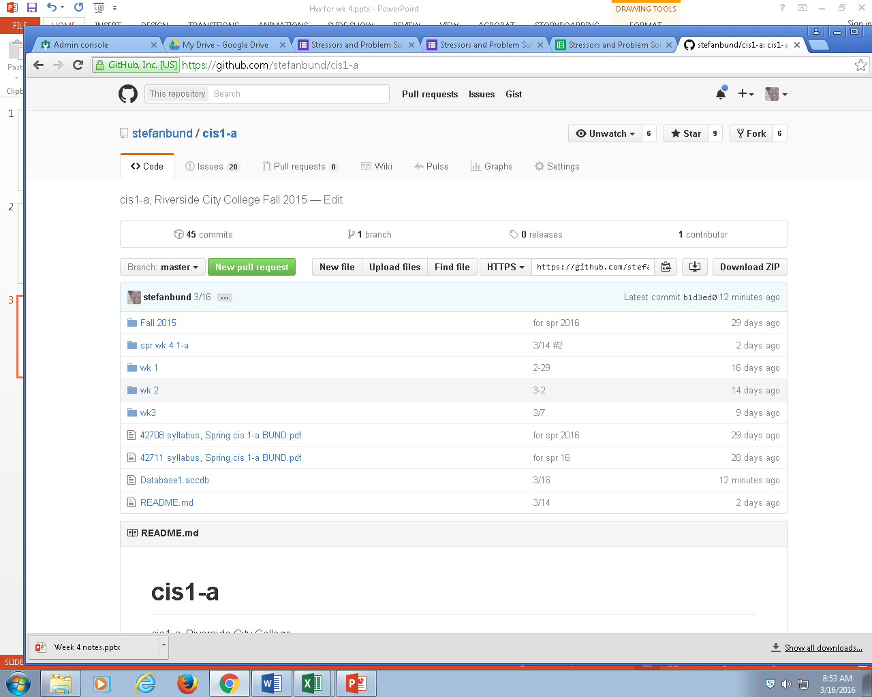
Step one, acquire database from github

Slide 4
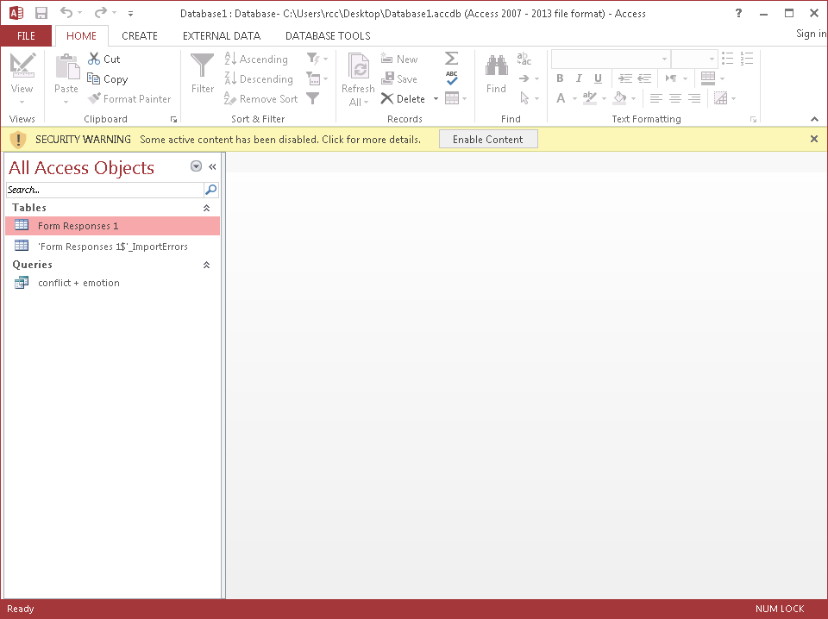
Step two: landscape, layout of access
Enable content, in yellow

Slide 5
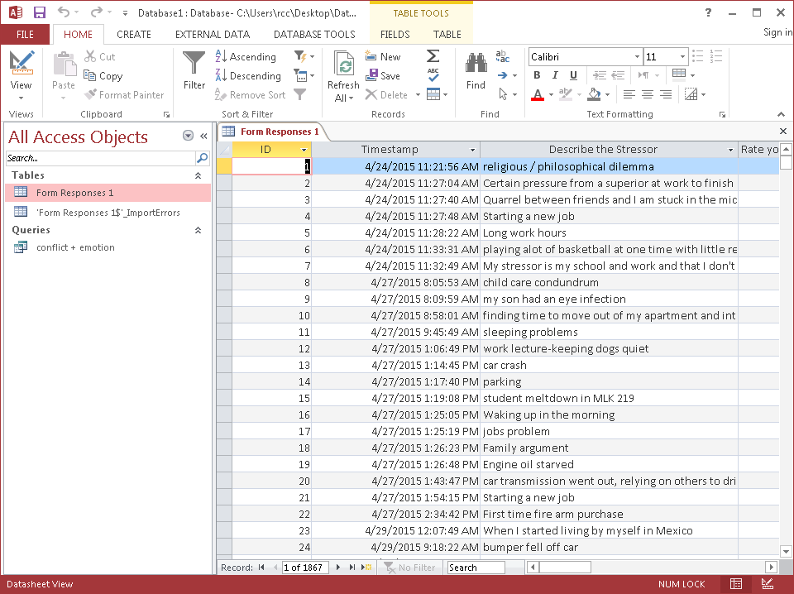
Study the original data

Slide 6
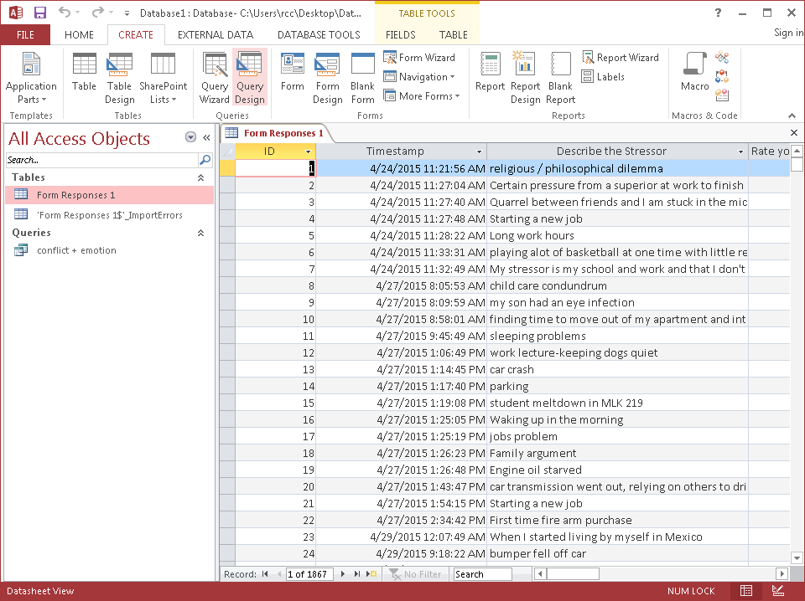
Initiate a query

Slide 7
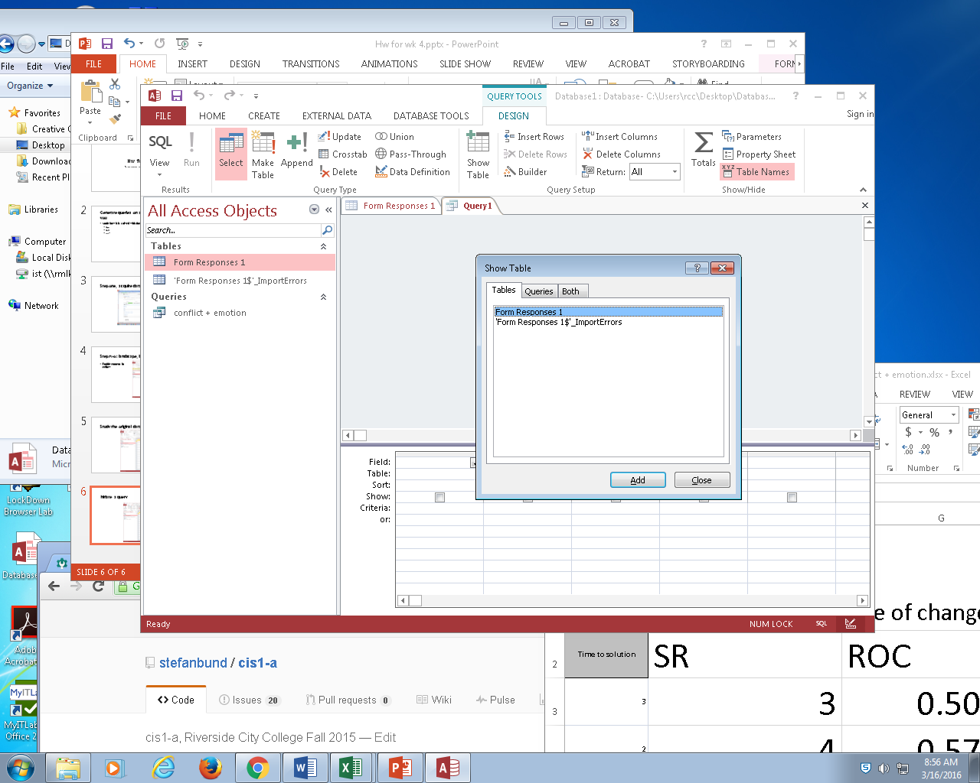
Choose the table under scrutiny,

Slide 8
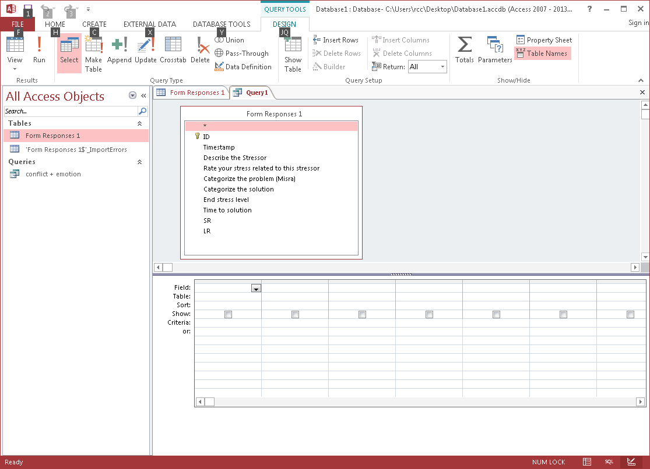
Illuminate the columns present

Slide 9
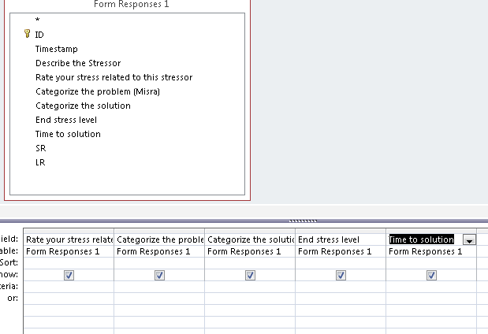
Choose the most relevant columns

Slide 10
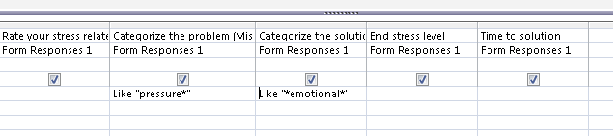
Enter criteria, using wildcards

Slide 11
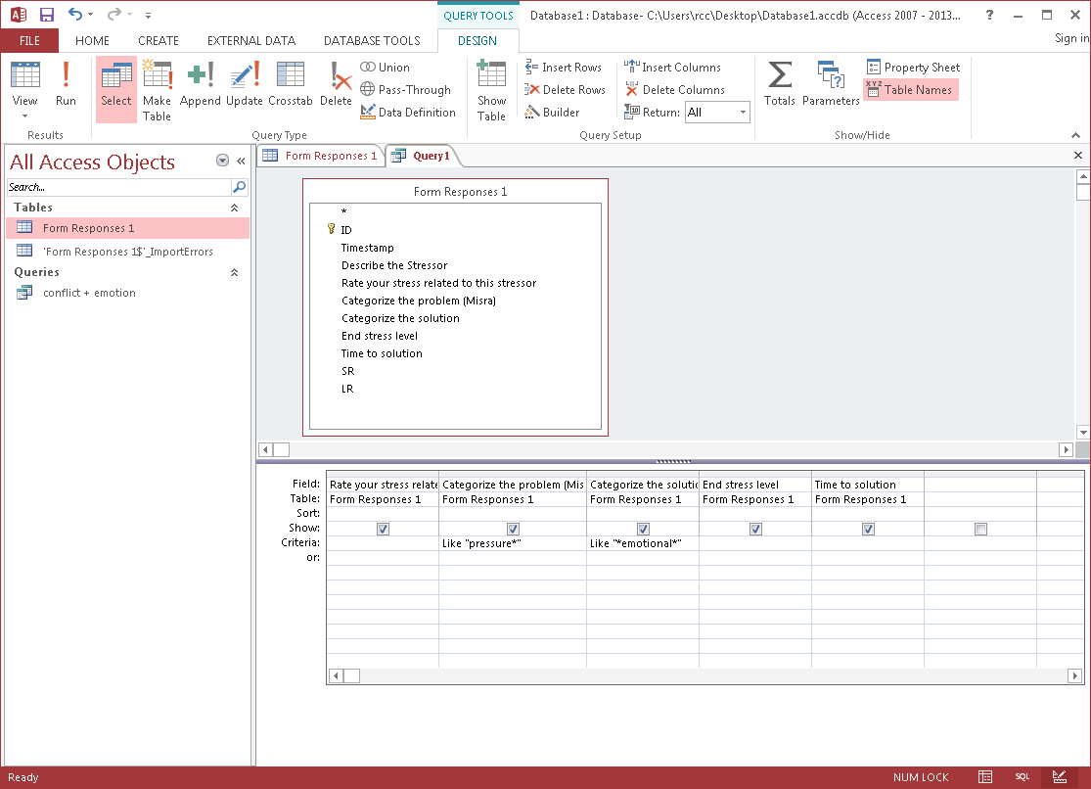
Move from design view to datasheet view, to see your results, ore press the ! button

Slide 12
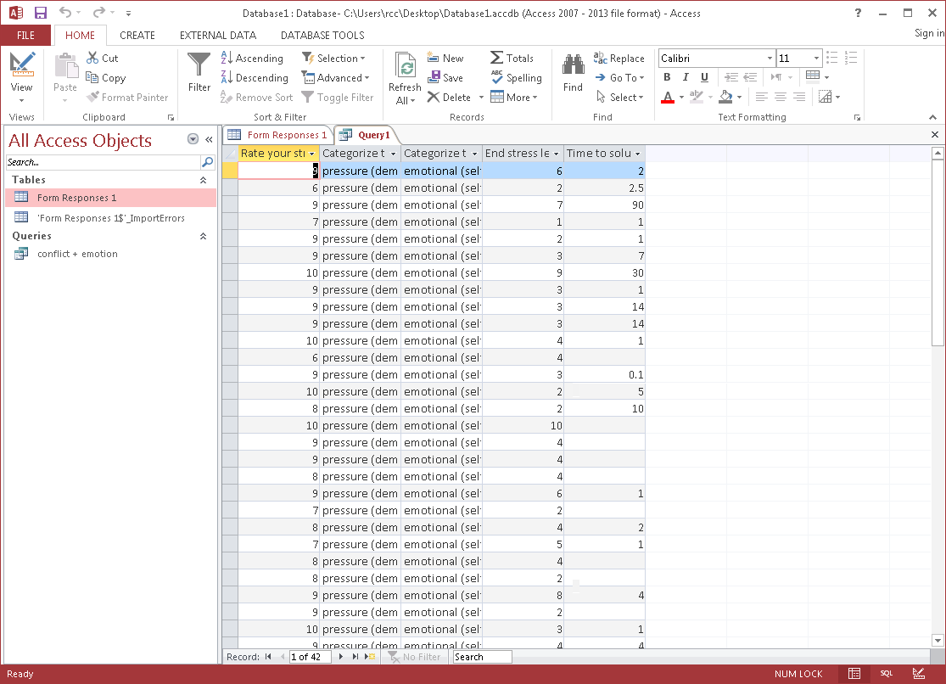
Lots of data happening

Slide 13
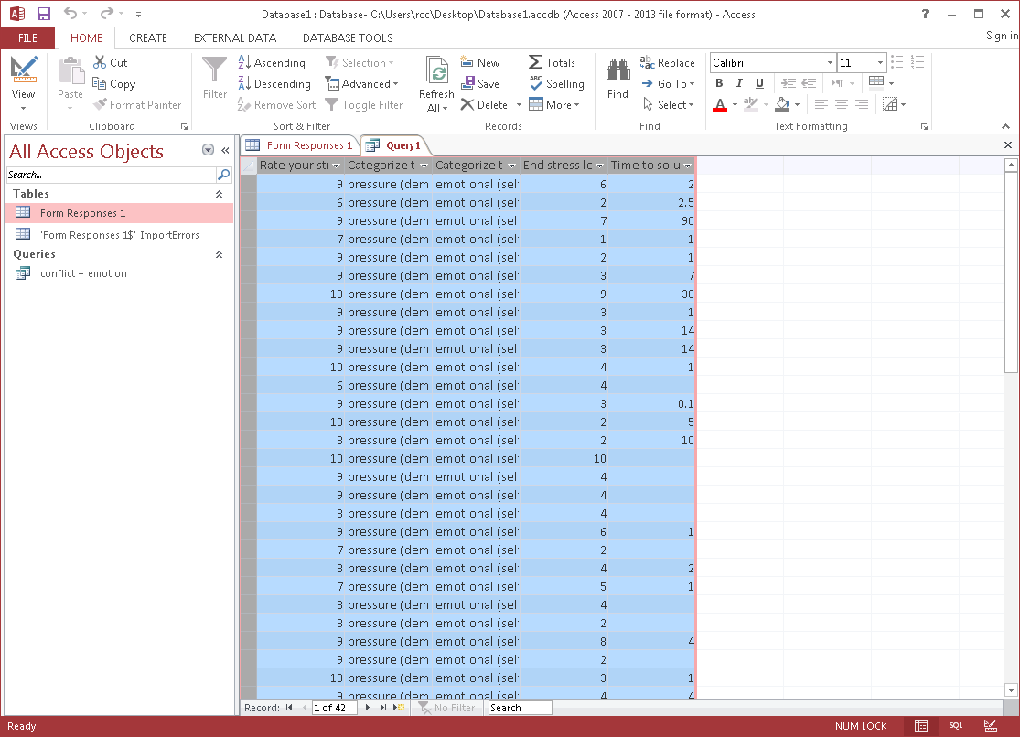
Transfer to excel via copy/ paste

Slide 14
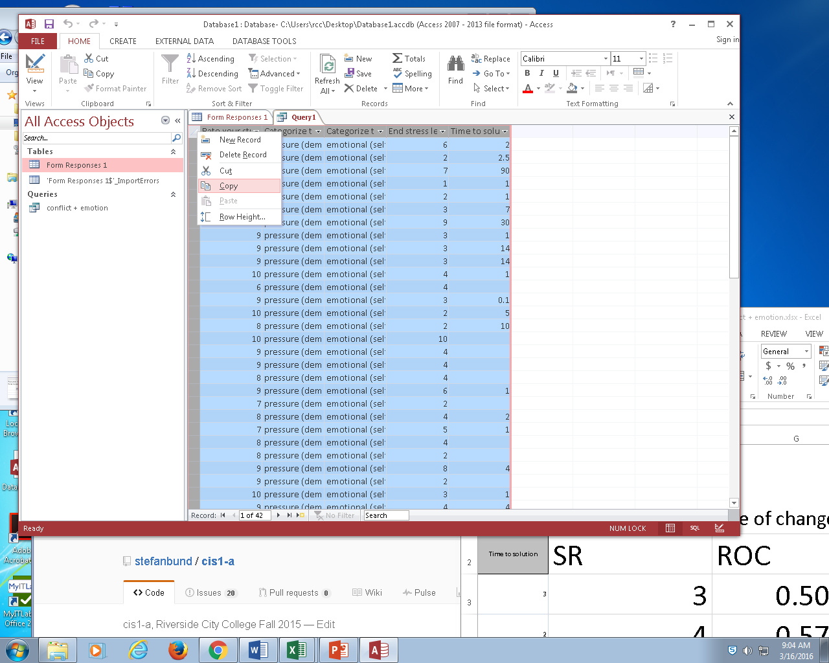
Copy in Access….

Slide 15
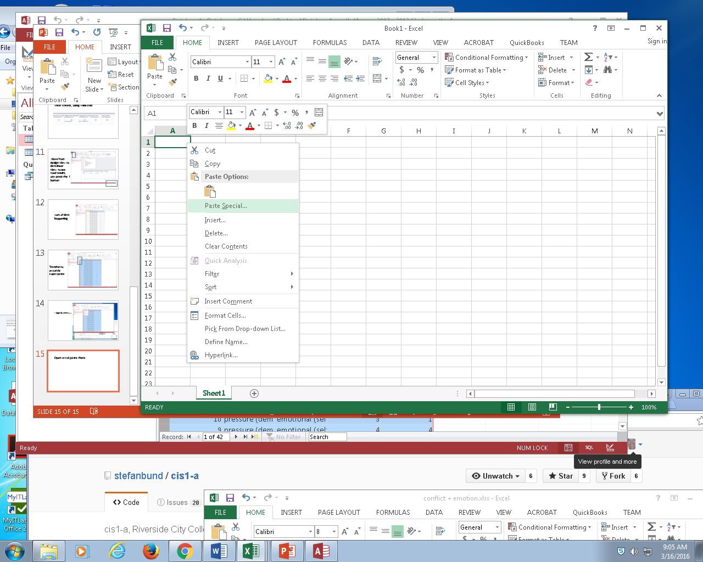
Open excel, paste there

Slide 16
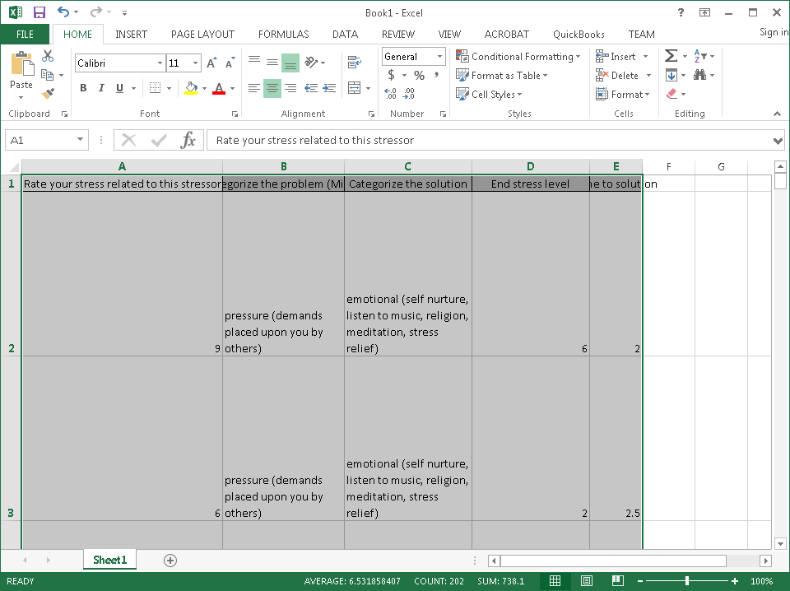
End product
Touch the edges of each column to expand each column
Save each new spreadsheet descriptively

Slide 17
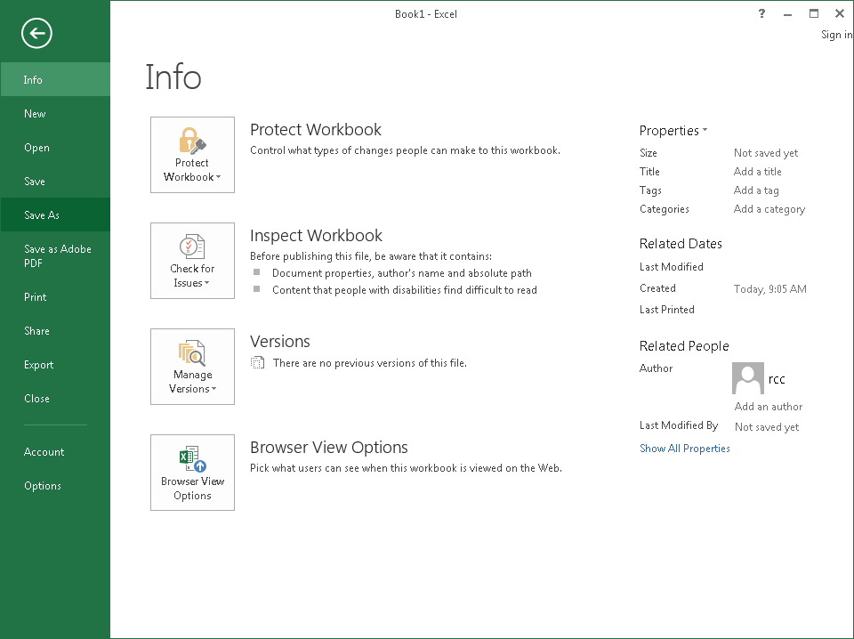
Save spreadsheet

Slide 18
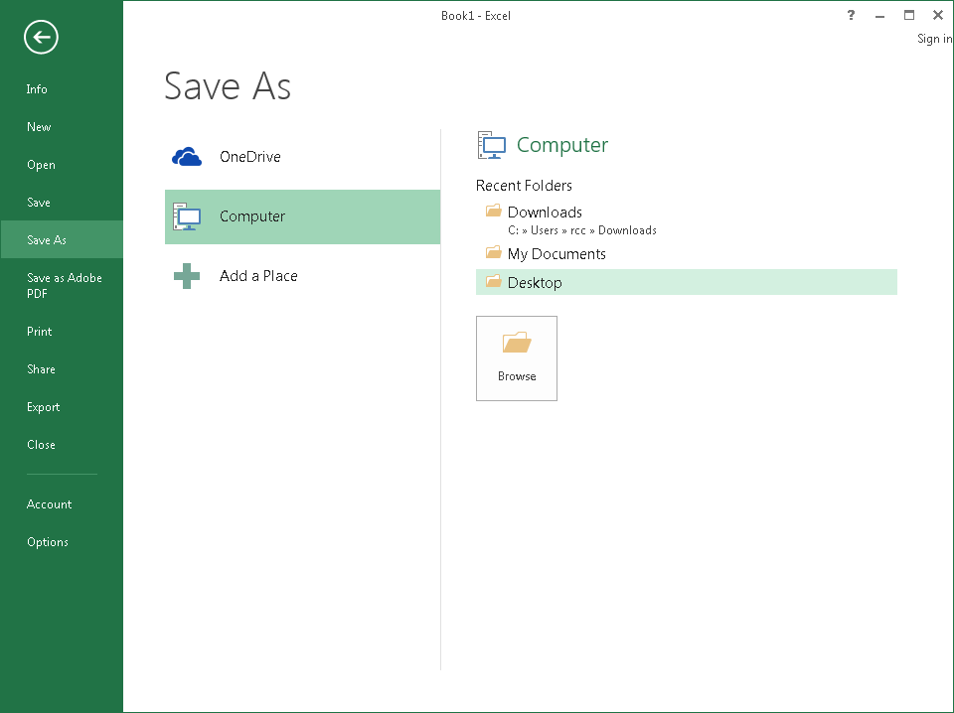

Slide 19
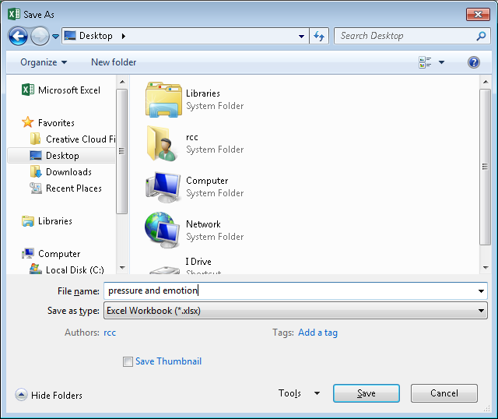

Slide 20
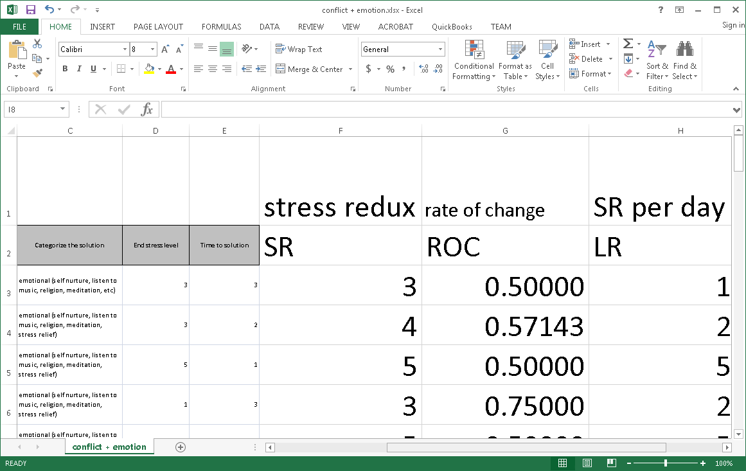
Next week we’ll work with the data on a final basis, to generate working statistics in excel

